Slide 1
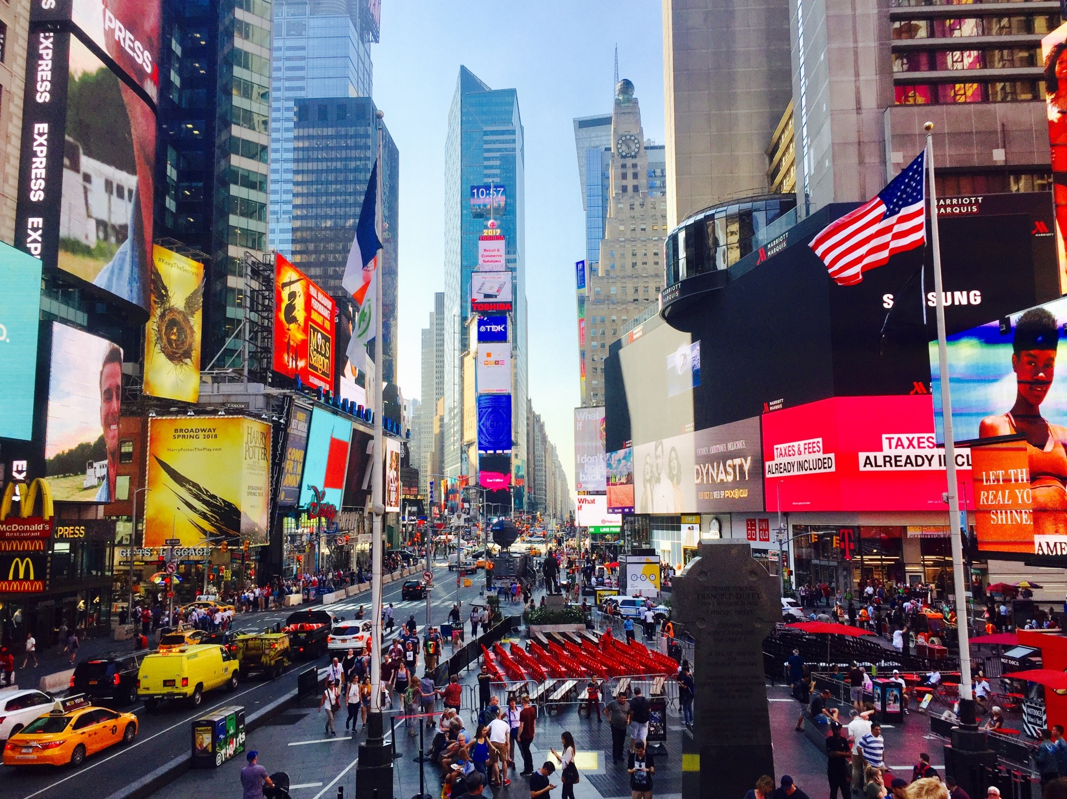
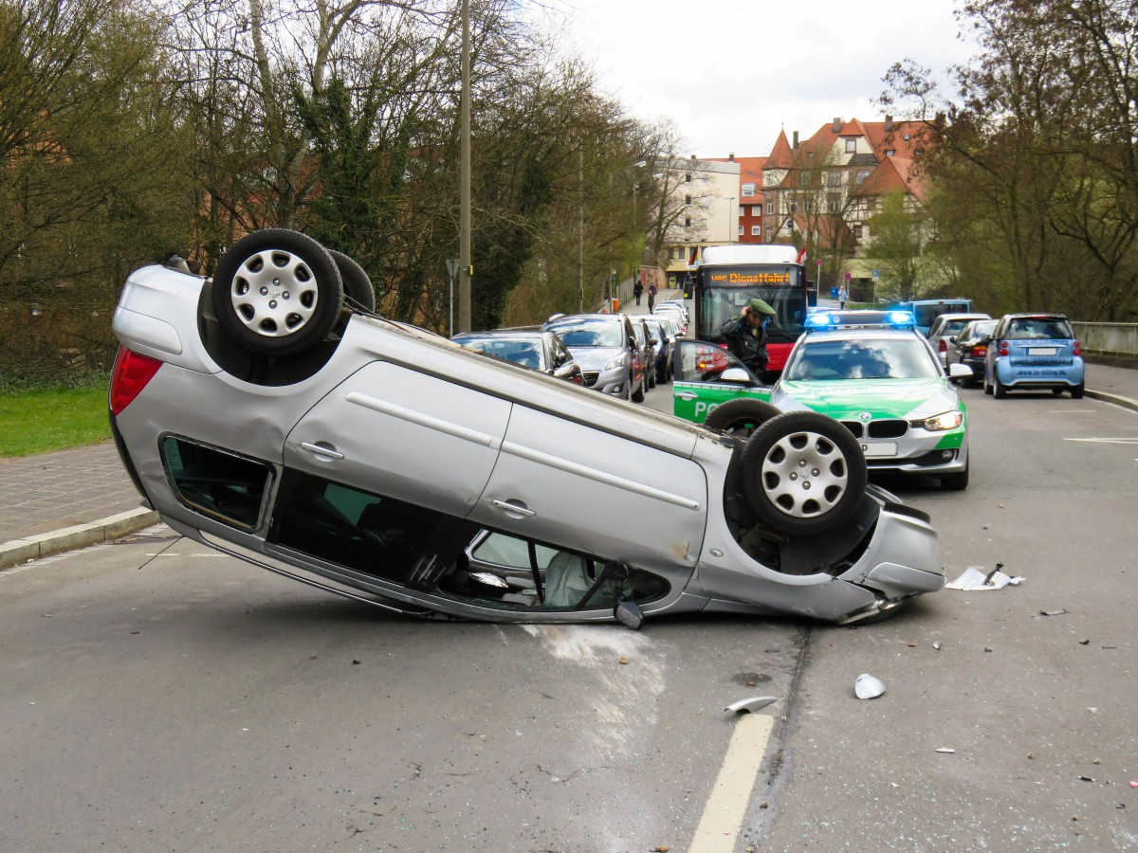
New York City Traffic Collision Analysis
https://catalog.data.gov/dataset/motor-vehicle-collisions-crashes

Slide 2
Project Initiation, Git Setup and Collaboration
Setup GIT Organization
Create GIT Repository
Add Team members to collaborate on the project files.
All team members cloned the repo and worked effectively to collaborate on the various aspects of the project
Explored and utilized Git LFS for handling large files over 100MB in Size

Slide 3
Project Scope
Analyze the NY City Motor vehicle Collision for the period of 2012 through 2023 Project Description/Outline Exploratory data analysis of the motor vehicle collisions in NY city Research Questions:
Which Borough had more incidents?
What time the collision mostly occurs ?
What kind of vehicles involved in collisions?
Injuries vs Fatalities.
What are the trends of collisions over the years?
What are the contributing factors for majority of the collisions?
Number of Motorists/pedestrians/cyclists/persons involved in the collisions.

Slide 4
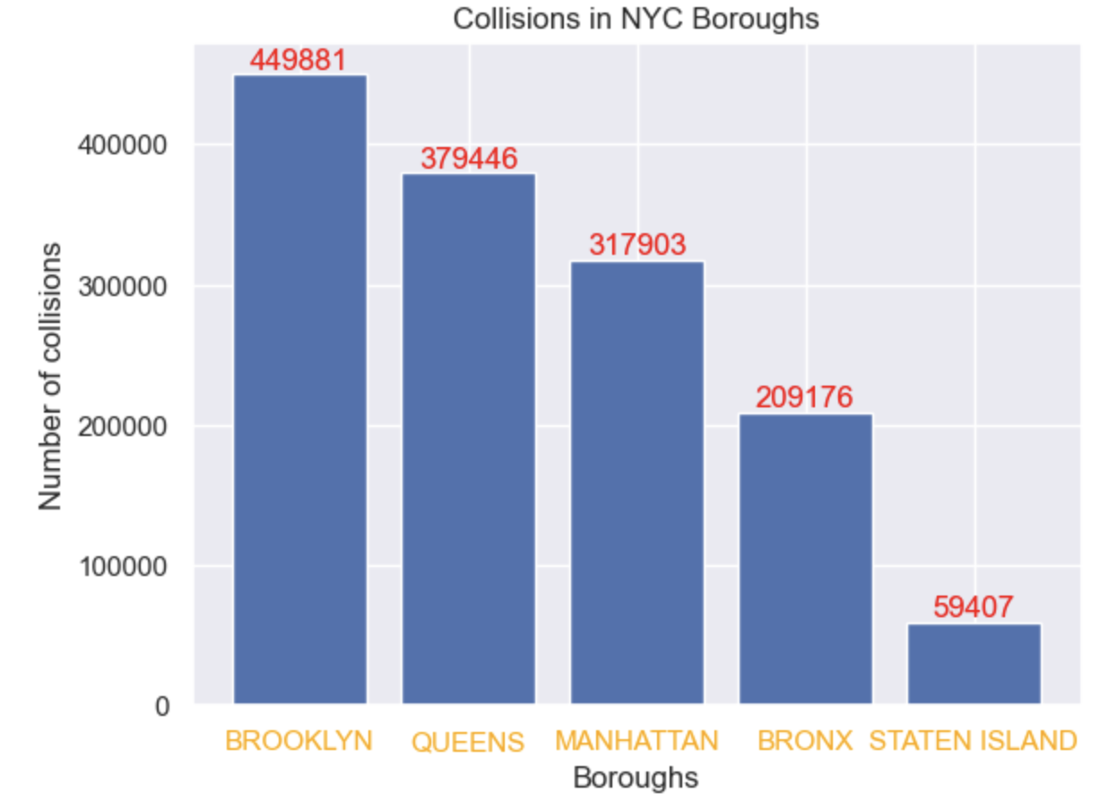
Collisions in each borough of NYC

Slide 5
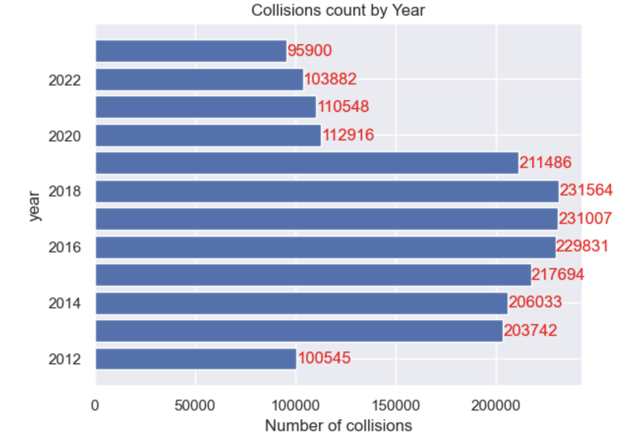
Collisions by the year

Slide 6
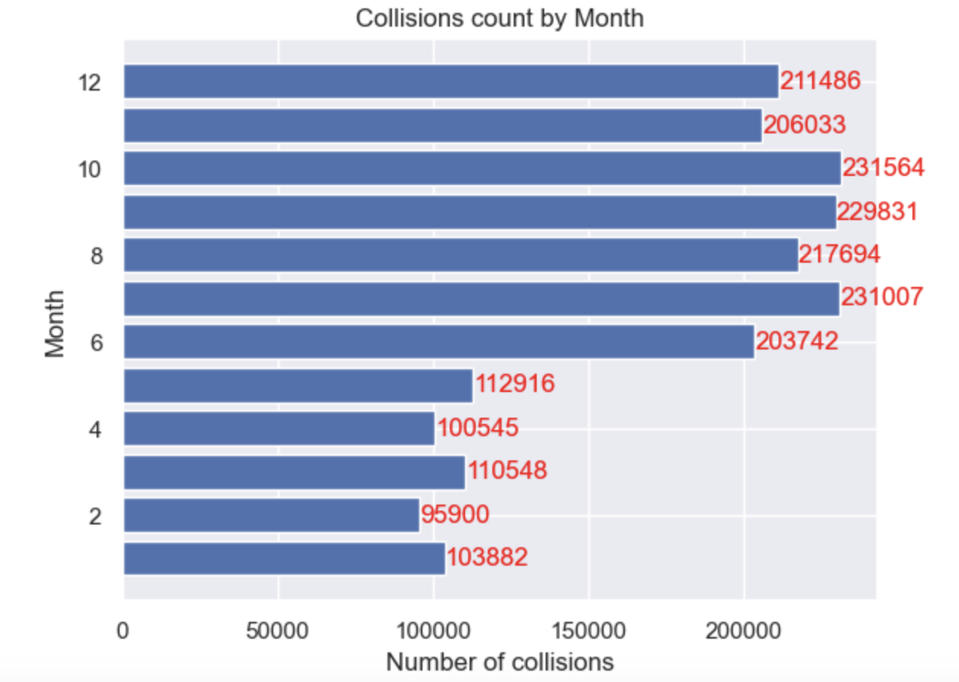
Collisions by the month

Slide 7
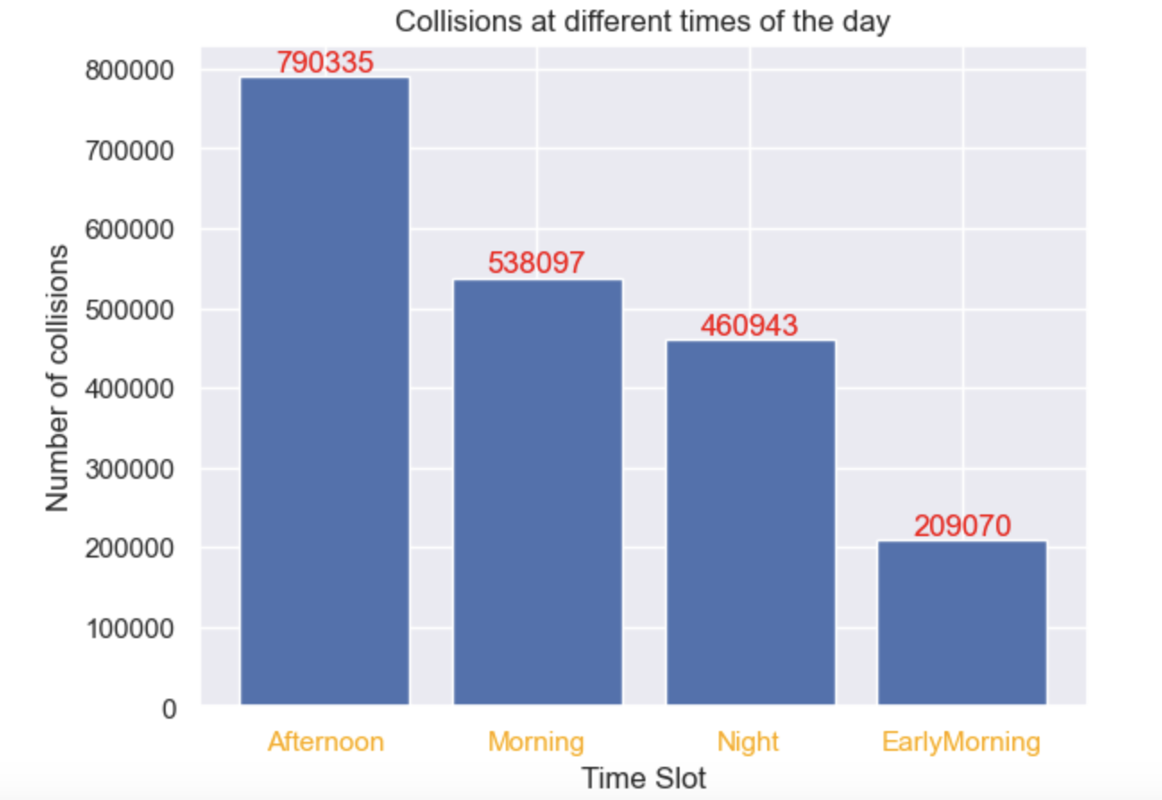
When did most accidents happen in the day?
EarlyMorning Hrs | 00:00-06:00
Morning Hrs | 06:00-12:00
Afternoon Hrs | 12:00-18:00
Night Hrs | 18:00-23:59

Slide 8
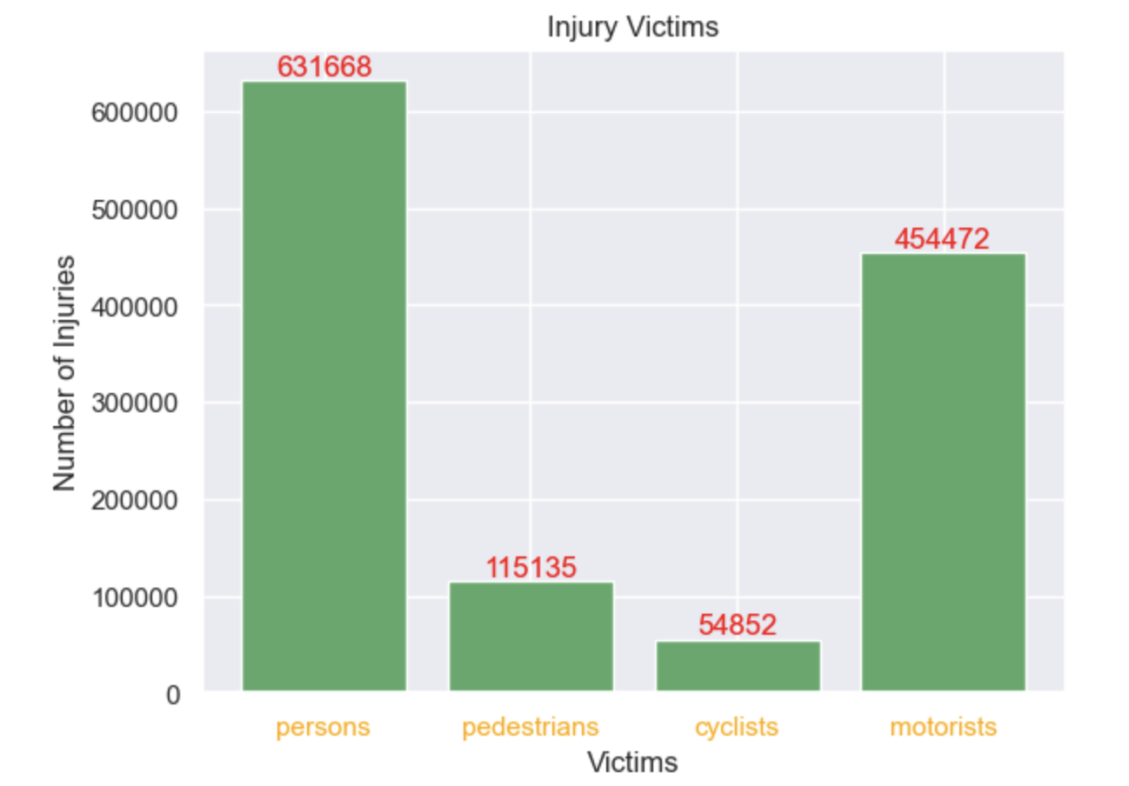
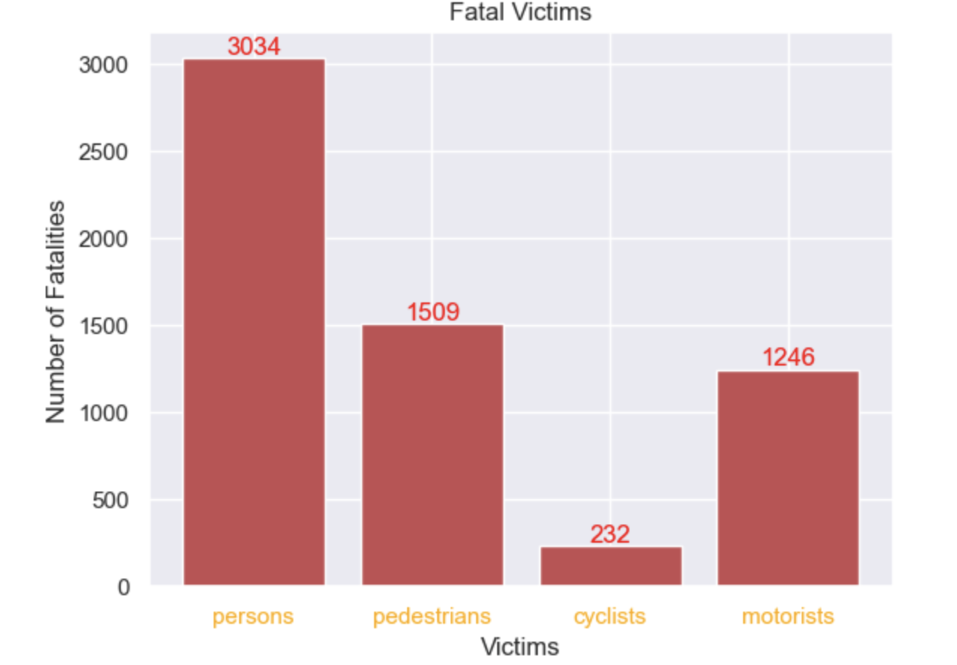
Injuries vs Fatalities

Slide 9
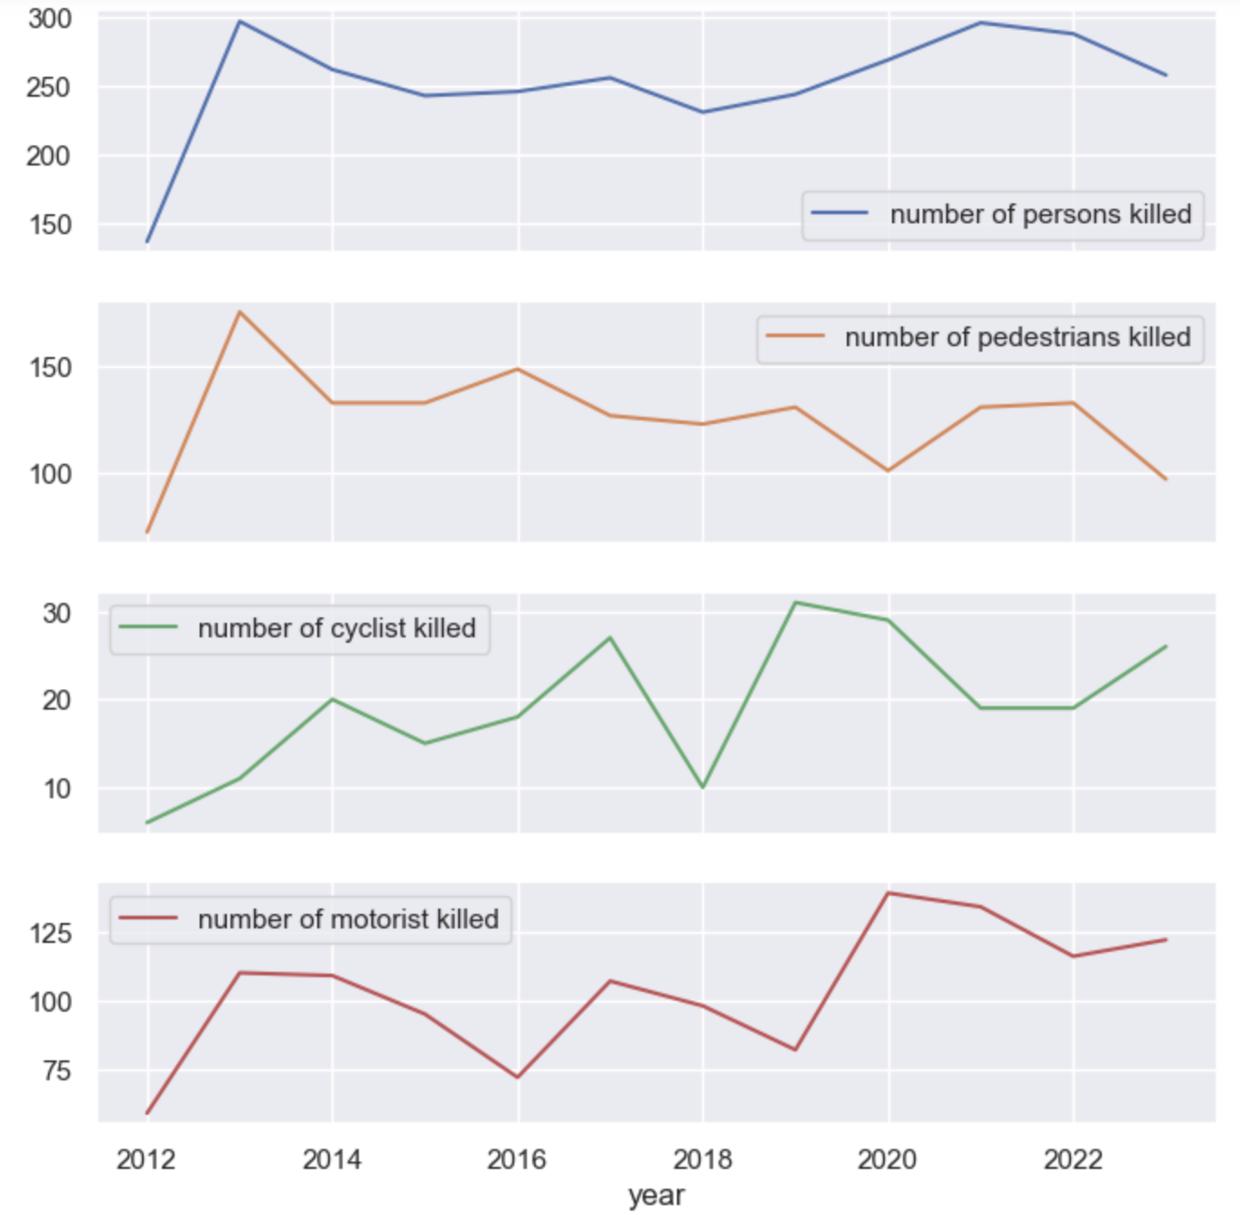
How Are fatalities trending ?

Slide 10
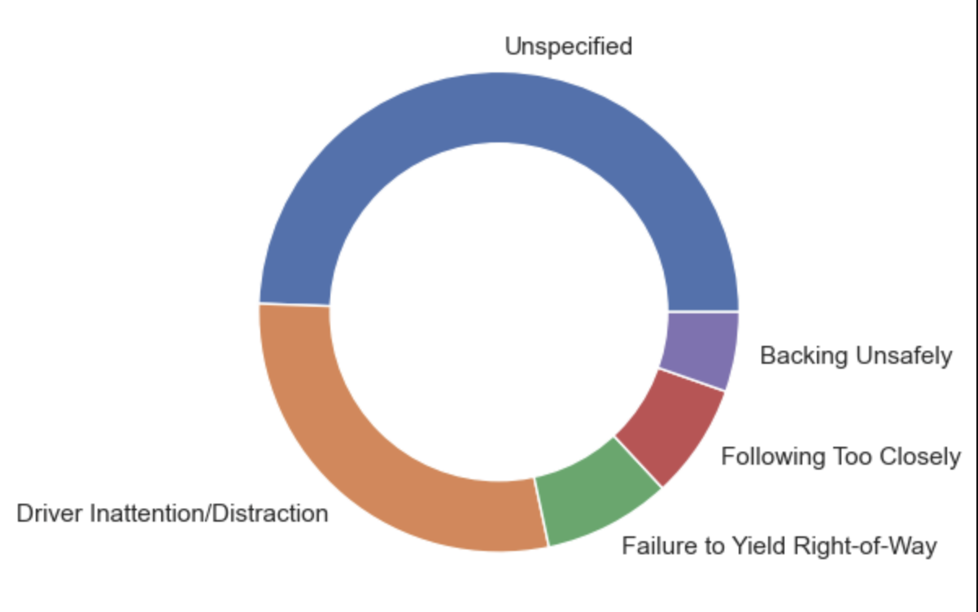
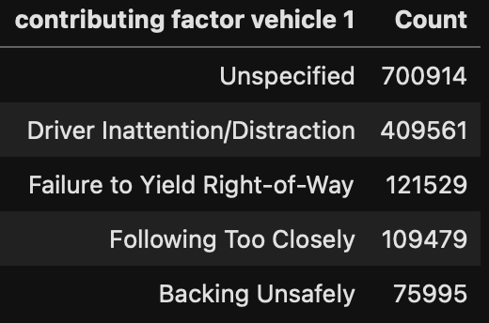
Top 5 factors for collisions

Slide 11
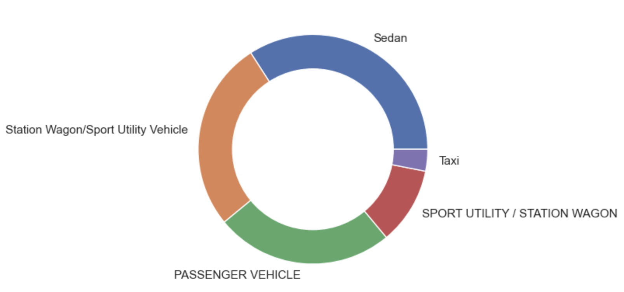
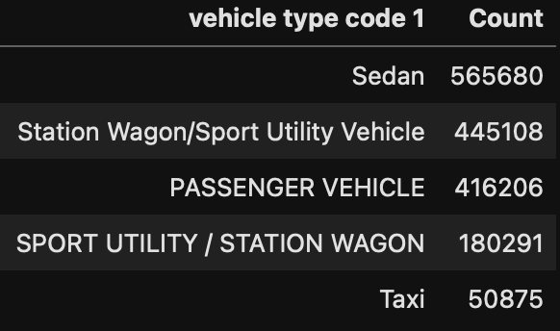
Top 5 vehicle types in collisions

Slide 12
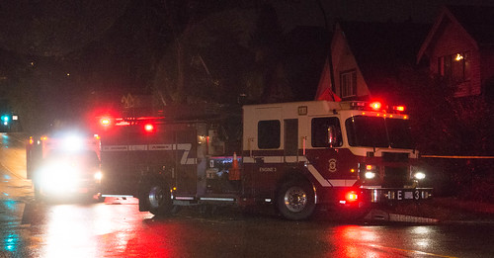
So, what’s the outcome?
Areas for attention:
Persons/pedestrians are major victims for fatalities
Brooklyn, Queens, Manhattan with higher collisions
More drivers during warmer months, so more crashes
Distracted and reckless drivers are the culprits
Sedans, SUVs and passenger vehicles are the problem
NYPD in Action for Safety

